Slide 1

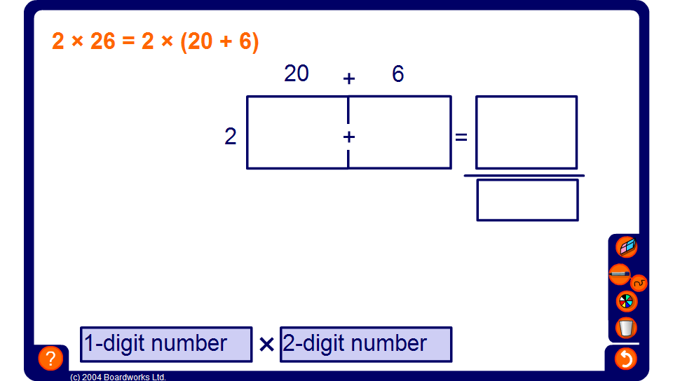


The grid method for multiplying whole numbers
Notes:
Pupils should have met this method for multiplying at Key Stage 2.
Use this slide to review the method.

